Slide 1
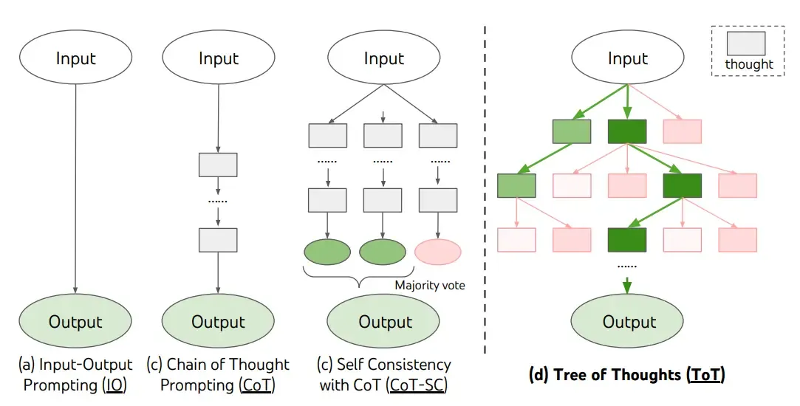
Chain-of-Thought (CoT): Step-by-Step Reasoning
Chain-of-Thought is a prompting technique that encourages the model to break down complex problems into intermediate steps.
By adding phrases like "Let’s think step by step," we force the AI to solve the logic before reaching a final conclusion.
This is essential for solving math word problems, symbolic logic, and multi-step reasoning where "Zero-shot" (direct) answering often fails.

Slide 2
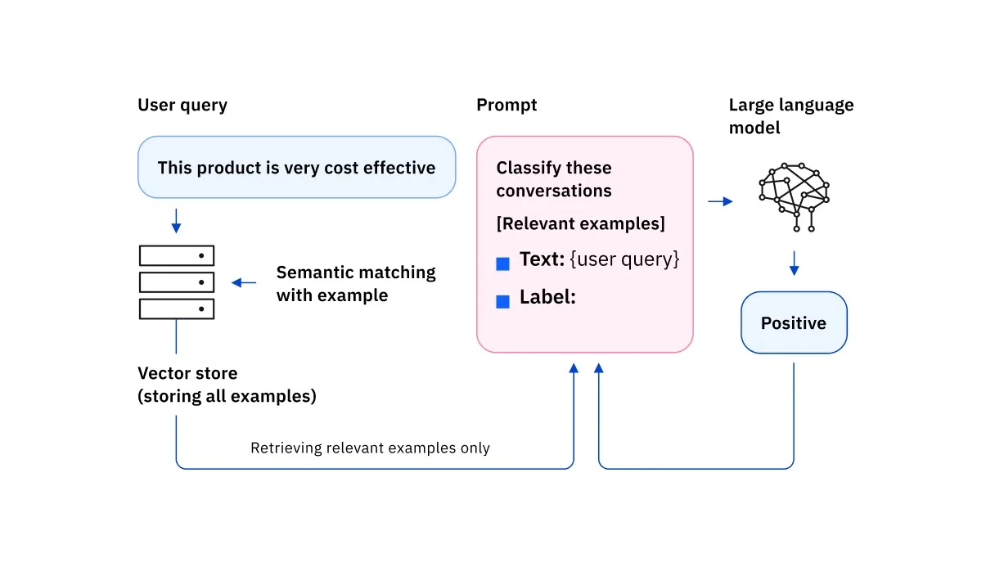
Few-Shot Prompting: Learning from Examples
Instead of just giving a command, we provide the model with a few examples of the desired input-output behavior.
Zero-shot: No examples given.
One-shot: A single example provided.
Few-shot: Multiple examples given to refine tone, format, and logic.
This helps the model understand complex patterns or specialized formatting without fine-tuning.

Slide 3
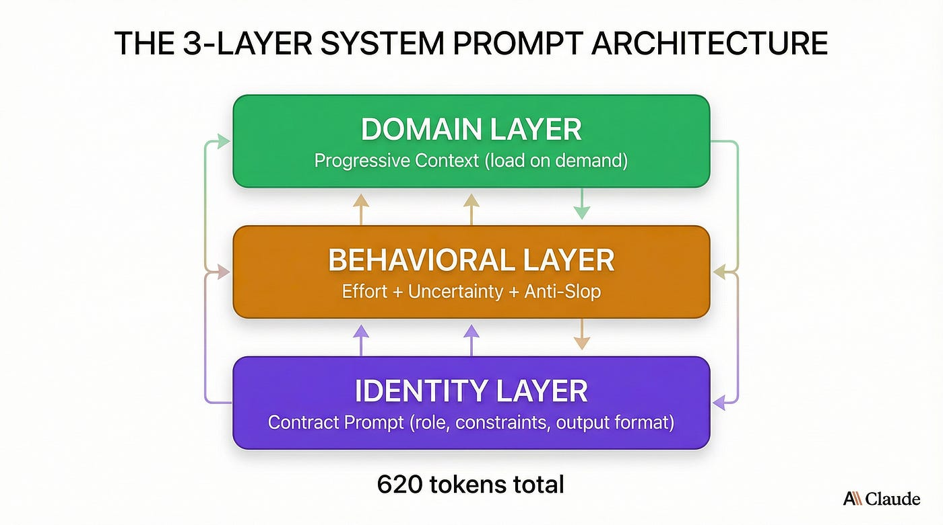
System Prompts: Identity and Constraints
The System Prompt (or System Message) acts as the "master instruction" for the LLM.
It sets the Identity (e.g., "You are a strict medical auditor") and Constraints (e.g., "Never use jargon" or "Keep responses under 50 words").
It provides a consistent framework for how the model should interact with the user throughout the session.

